Slide 1
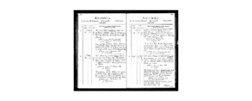
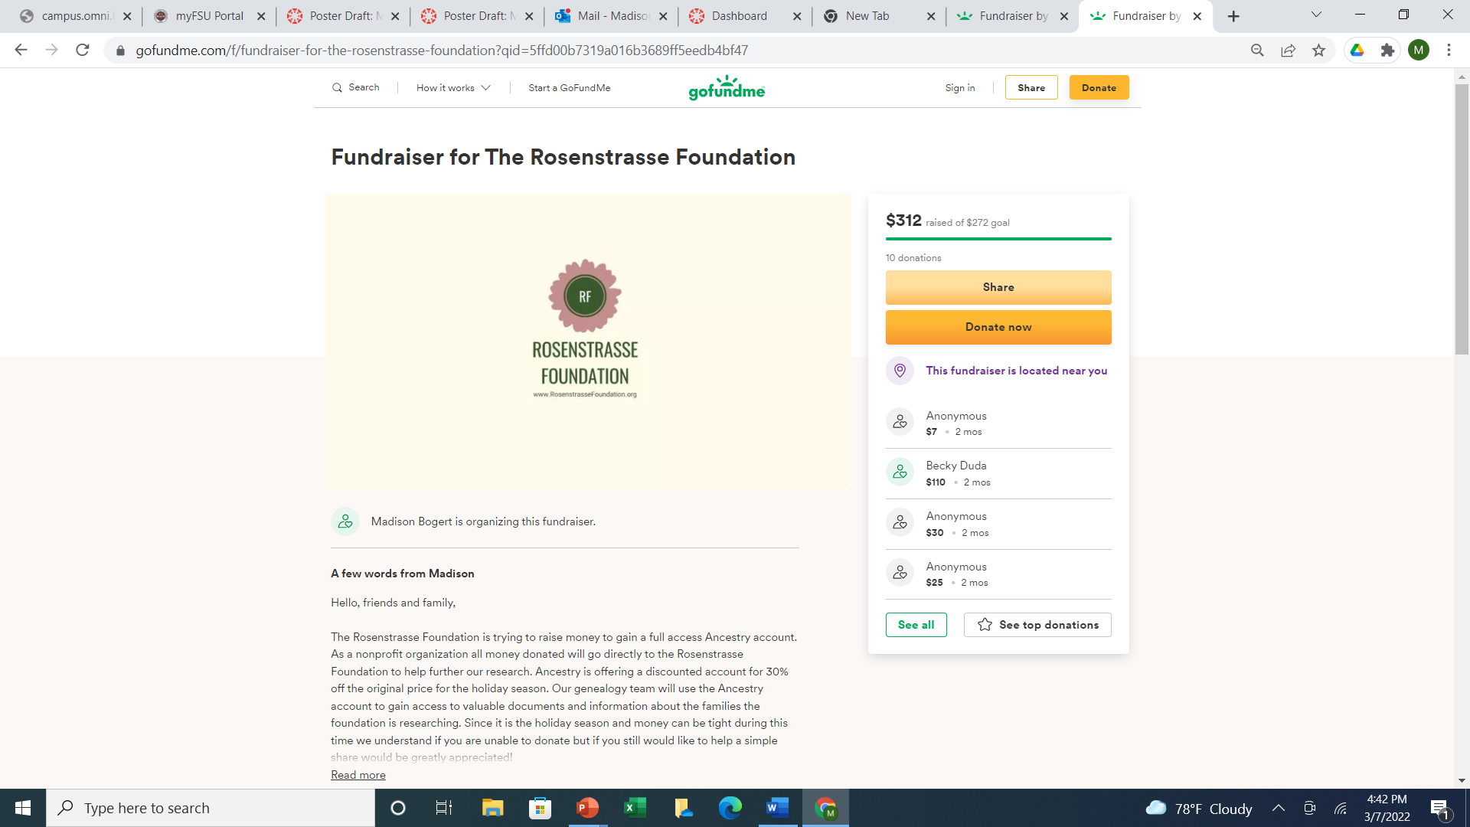
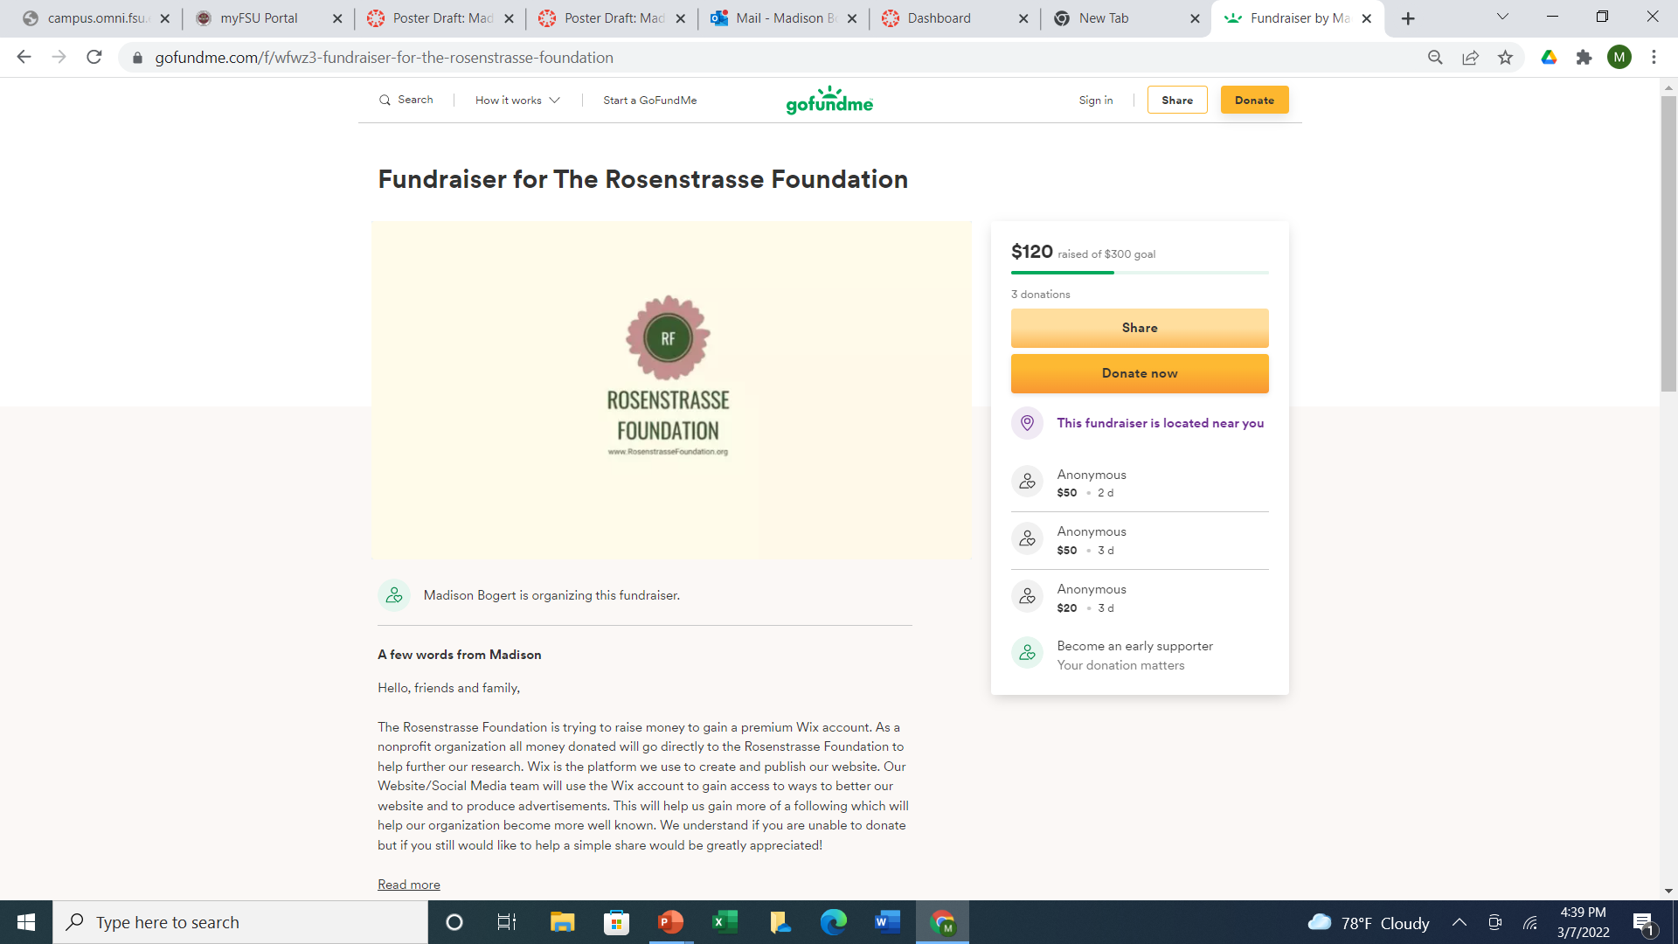
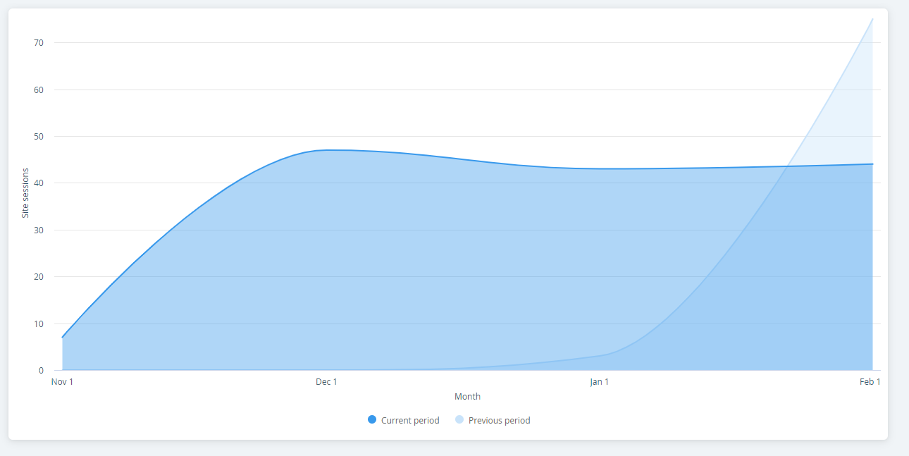
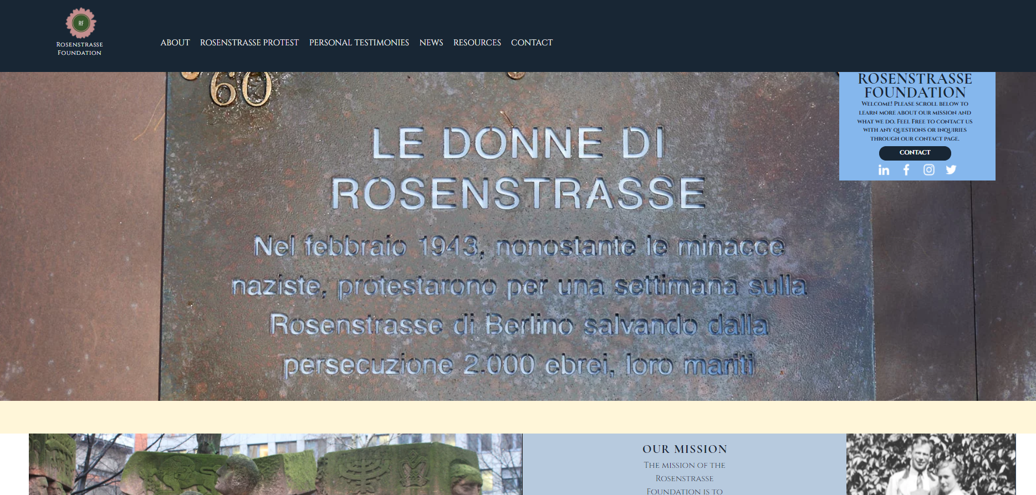
The Rosenstrasse Foundation: Nonprofit Fundraising
Madison Bogert, Mary Moshos, Robert “Trey” Cochenour;
Nathan Stoltzfus, Liam Wirsanksy
Florida State University
Introduction
Abstract
Conclusion
The Foundation was given its name in remembrance of the 1943 Rosenstrasse Protest, taking place on “Rose Street” in central Berlin. It is rooted around amplifying the intermarriage relationships and specific voices of civil courage during World War II. Non-Jewish women married to Jewish men defied Hitler’s regime to protest the capture of their husbands, leading to the men’s ultimate release. Overall, our foundation is dedicated to the development of knowledge about this and other acts of women-led defiance in addition to acts of civil courage more generally. As stated on the foundation’s website, social media pages, and by our researchers alike, the mission of the Rosenstrasse Foundation is “to commemorate, encourage, and educate about civil courage-- concrete acts in opposition to injustice and human rights violations that defend the values of a pluralistic society.”
Our fundraising team worked together to create a GoFundMe to help further the research of the Rosenstrasse Foundation. This GoFundMe page was specifically catered to gaining full access to an Ancestry.com account. Since Ancestry was offering a discounted holiday special, it seemed like the best opportunity to start fundraising. This account was dedicated to our genealogy team, and they use the account to gain access to valuable documents and information about the families the foundation is currently researching. Then the documents and information is sent to our biography team, where they write up biographies on these families. After the biographies are edited and finalized, they are sent to our website and social media team where it is directly published to our website. We are currently working on publishing a second GoFundMe fundraising campaign to gain access to a premium Wix account. Which will then be used to help our Foundation’s website have a more professional appeal. The premium account will also help us produce advertisements to gain more followers for our foundation.
The fundraiser was successful and showed us that we have the resources to produce more fundraisers in the future. This allowed the research assistants of the Rosenstrasse foundation to have the tools they needed to complete their research. We are currently working with Florida State University to get our nonprofit organization to be a registered student organization. This will help our organization become more well known and will give us more options when it comes to spreading awareness and raising money. This will be a huge advancement for the foundation, as it can help ensure that we can keep our annual premium Wix and ancestry account, while also ensuring more followers. The Rosenstrasse Foundation is excited for the future as we watch the foundation grow.
Methods
Acknowledgements
References
We met with our project manager ,Liam Wirsansky, to discuss the possibility of starting a fundraiser.
After getting approval, we worked together to produce a description to put under our fundraiser. Once getting approval on the description of the GoFundMe, we published the fundraiser, it was then live to the public
We shared the link to the fundraiser with the other research assistants and started to share the GoFundMe with our families and friends
After about a week of pushing the GoFundMe, through multiple posts on Facebook and Instagram, we raised enough money to purchase the full access ancestry account
Berghahn, Volker R, and LässigSimone. Biography between Structure and Agency : Central European Lives in International Historiography. New York: Berghahn Books, 2008.
Fagin-Jones, Stephanie. “Book Review: Unlikely Heroes: The Place of Holocaust Rescuers in Research and Teaching.” Heroism Science: An Interdisciplinary Journal 4, no. 1 (2019). https://doi.org/10.26736/hs.2019.01.03.
Gruner, Wolf. Widerstand in Der Rosenstrasse : Die Fabrik-Aktion Und Die Verfolgung Der “Mischehen” 1943. Frankfurt Am Main: Fischer Taschenbuch Verlag, 2005.
Mary Moshos, Research Assistant. “LinkedIn Login, Sign in | LinkedIn.” LinkedIn, 2022. https://www.linkedin.com/company/80445110/admin/.
Potter, Hilary. “‘MAN KANN DER VERANTWORTUNG NICHT ENTRINNEN’: REMEMBERING ROSENSTRASSE SEVENTY‐FIVE YEARS ON.” German Life and Letters 73, no. 3 (July 2020): 383–400. https://doi.org/10.1111/glal.12273.
“Resistance of the Heart: Intermarriage and the Rosenstrasse Protest in Nazi Germany.” Choice Reviews Online 34, no. 08 (April 1, 1997): 34–465334–4653. https://doi.org/10.5860/choice.34-4653.
Rosenstrasse Foundation Team. “ABOUT.” rosenstrassefoundation.org. Accessed February 25, 2022. http://rosenstrassefoundation.org/about/.
———. “HOME.” My Site, 2021. https://rosenstrassefounda.wixsite.com/my-site.
Social Media Team, Rosenstrasse Foundation. “Https://Twitter.com/Rosenstrassef.” Twitter. Accessed February 25, 2022. https://twitter.com/rosenstrassef?lang=en.
———. “Rosenstrasse Foundation.” www.facebook.com. Accessed February 25, 2022. https://www.facebook.com/Rosenstrasse-Foundation-101574755311314.
Social Media Team, Rosenstrassse Foundation. “Login • Instagram.” www.instagram.com. Accessed February 25, 2022. https://www.instagram.com/rosenstrassefoundation/?hl=en.
Stoltzfus, Nathan. Hitler’s Compromises : Coercion and Consensus in Nazi Germany. New Haven Etc.: Yale University Press. Copyright, 2016.
———. Resistance of the Heart Intermarriage and the Rosenstrasse Protest in Nazi Germany. New Brunswick, Nj London Rutgers Univ. Press, 2001.
Nathan Stoltzfus (Ph.D. Harvard 1993) is the Dorothy and Jonathan Rintels Professor of Holocaust Studies at Florida State University and is the author and editor of multiple books analyzing zivilcourage in World War 2.
Website Traffic Over Time

